Slide 1

Project Flags
CAPTURE THE FLAG CHALLENGES
Hacking for good

Slide 2
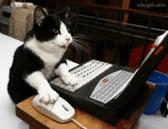
  Definition: Capture the flag challenges are ways that we can compete and prove our skills in a ethical environment
  Objective: We are going to go over how to compete in a competition and go over studying for one.
  And... Win some competitions.
THE OBJECTIVES

Slide 3
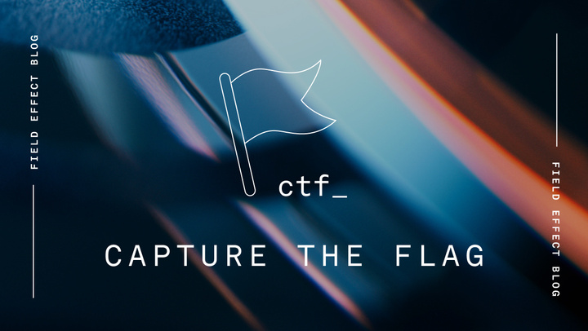
WHY TRY CAPTURE THE FLAGS?
  Demonstrate practical security skill to employers
  Network with Cybersecurity Professionals
  An amazing resume builder.
  Where do you land in cybersecurity?

Slide 4
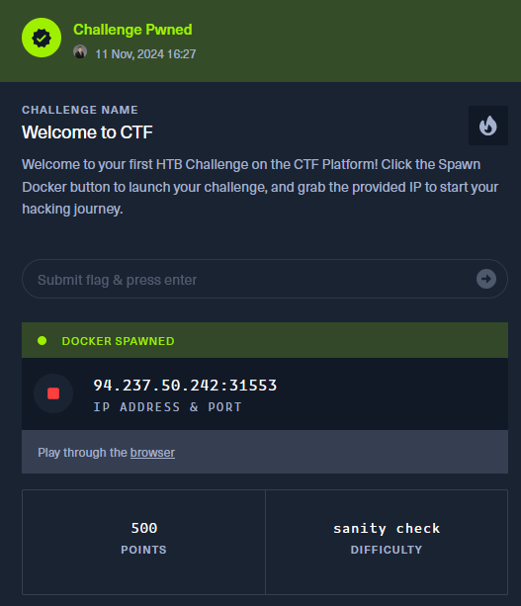
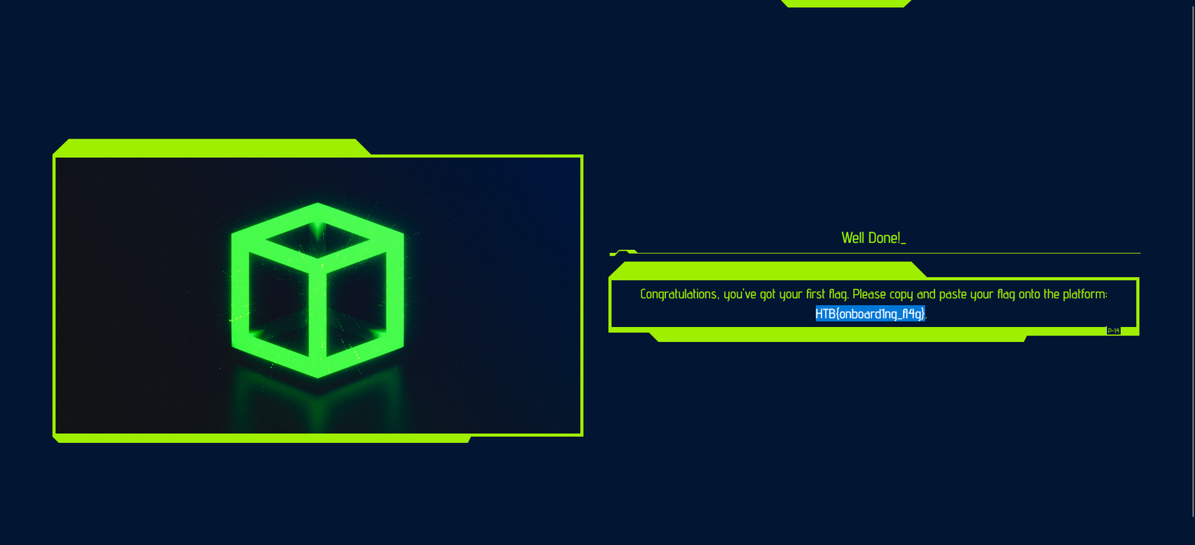
UNDERSTANDING A CTF
A CTF: An exercise which participants attempt to find text strings (Flags) which are hidden in systems
HTB{onboard1ng_fl4g}

Slide 5

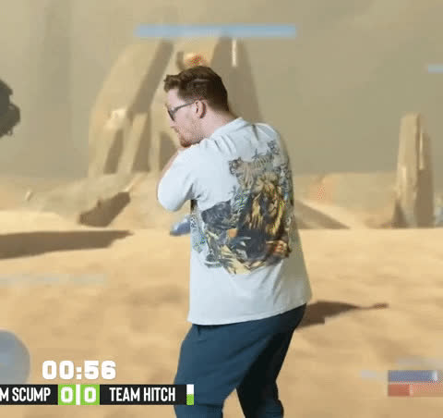
TYPES OF CTFS
Jeopardy-Style
Attack - Defense
  Multiple challenge categories
  Collegiate Cyber Defence Competition
  The classic “Text challenges”
  Defending servers against attack / Attacking others
  Decode: ZmxhZ3tmbGFnfQ==
flag{flag}
  Not currently in scope for our CTF team

Slide 6
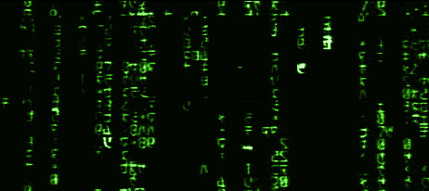
WHAT KINDS OF CHALLENGES WILL WE SEE?
“Active”
  PWN aka compromise a machine
  WEB Web vulnerabilities (sql injection, fuzzing, etc)
  ICS - Industrial Control Systems (Rare)
“Passive (No Server interaction)
  Warm ups
  Cryptography
  Reversing
  Foresnsics
  Misc

Slide 7
WHEN YOU ARE STUCK:
TIPS AND TRICKS
  MOVE ON - If you can’t figure it out right now sometimes it is best to move on
  Find a new approach – Look for write ups in the area you are working on. SEe if there is a new approach
  TEAM HELP - Gather ideas from friends and see if they can assist, working together on a challenge can help bring new perspectives

Slide 8
A NOTE ABOUT THE CHALENGING NATURE
"The expert in anything was once a beginner who refused to give up."
- Helen Hayes

Slide 9
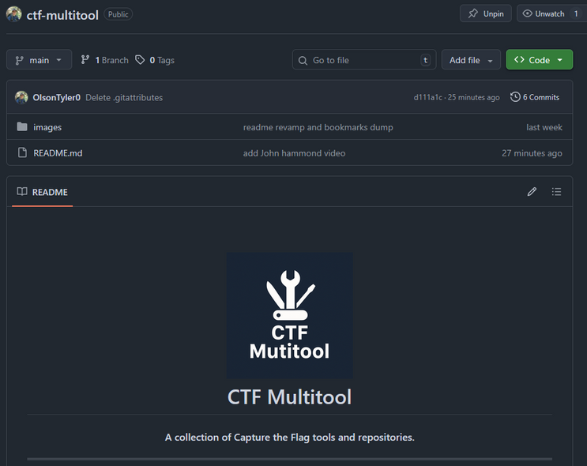
THE TOOLING
  As we continue with training I’ll share more of the tooling we use.
  Githubs with massive amounts of tools collected over time “CTF tool list site:Github.com”
  Custom github repo at:
    https://github.com/OlsonTyler0/ctf-multitool

Slide 10
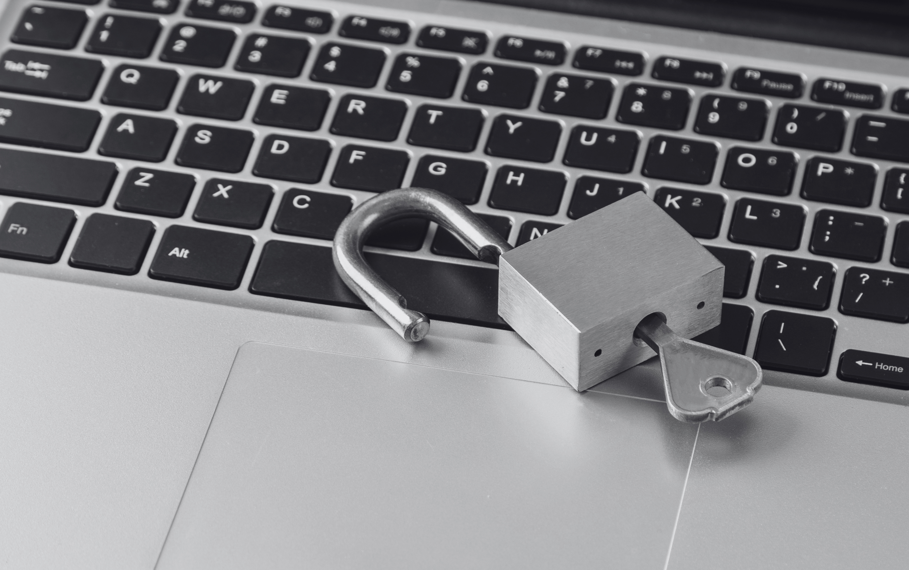
LETS LOOK AT TODAY’S CTF!

Slide 11

THANK YOU
https://github.com/msu-abits/2025-cybersecurity

